Slide 1
COMP2068 – Advanced Web Programming
Lesson 4
Express.js

Slide 2
Lesson Objectives
In this Lesson you will learn about:
Express.js middleware
Twitter Bootstrap for layout
Cloud implementation for a Node.js app

Slide 3
Developing Node.js web applications
Node.js is a platform that supports various types of applications, but the most popular kind is the development of web applications.
Node's style of coding depends on the community to extend the platform through third-party modules; these modules are then built upon to create new modules, and so on.
Companies and single developers around the globe are participating in this process by creating modules that wrap the basic Node APIs and deliver a better starting point for application development.

Slide 4
Developing Node.js web applications (cont’d)
There are many modules to support web application development but none as popular as the Connect module.
The Connect module delivers a set of wrappers around the Node.js low-level APIs to enable the development of rich web application frameworks.

Slide 5
Developing Node.js web applications (cont’d)
To understand what Connect is all about, let's begin with a basic example of a basic Node web server.
In your working folder, create a file named server.js, which contains the following code snippet:
var http = require('http');
http.createServer(function(req, res) {
res.writeHead(200, {
'Content-Type': 'text/plain'
});
res.end('Hello World');
}).listen(3000);
console.log('Server running at http://localhost:3000/');

Slide 6
Developing Node.js web applications (cont’d)
To start your web server, use your command-line tool, and navigate to your working folder.
Then, run the node CLI tool and run the server.js file as follows:
$ node server
Now open http://localhost:3000 in your browser, and you'll see the Hello World response.

Slide 7
Developing Node.js web applications (cont’d)
So how does this work?
In this example, the http module is used to create a small web server listening to the 3000 port.
You begin by requiring the http module and use the createServer() method to return a new server object.
The listen() method is then used to listen to the 3000 port.
Notice the callback function (anonymous function) that is passed as an argument to the createServer() method.

Slide 8
Developing Node.js web applications (cont’d)
The callback function gets called whenever there's an HTTP request sent to the web server.
The server object will then pass the req and res arguments, which contain the information and functionality needed to send back an HTTP response.
The callback function will then do the following two steps:
First, it will call the writeHead() method of the response object. This method is used to set the response HTTP headers. In this example, it will set the Content-Type header value to text/plain. For instance, when responding with HTML, you just need to replace text/plain with html/plain.
Then, it will call the end() method of the response object. This method is used to finalize the response. The end() method takes a single string argument that it will use as the HTTP response body. Another common way of writing this is to add a write() method before the end() method and then call the end() method, as follows:
res.write('Hello World');
res.end();

Slide 9
Meet the Connect module
Connect is a module built to support interception of requests in a more modular approach.
In the first web server example, you learned how to build a simple web server using the http module.
If you wish to extend this example, you'd have to write code that manages the different HTTP requests sent to your server, handles them properly, and responds to each request with the correct response.

Slide 10
Meet the Connect module (cont’d)
Connect creates an API exactly for that purpose – it uses a modular component called middleware, which allows you to simply register your application logic to predefined HTTP request scenarios.
Connect middleware are basically callback functions, which get executed when an HTTP request occurs.
The middleware can then perform some logic, return a response, or call the next registered middleware.
While you will mostly write custom middleware to support your application needs, Connect also includes some common middleware to support logging, static file serving, and more.

Slide 11
Meet the Connect module (cont’d)
The way a Connect application works is by using an object called dispatcher.
The dispatcher object handles each HTTP request received by the server and then decides, in a cascading way, the order of middleware execution.

Slide 12
Meet the Connect module (cont’d)
In the next section, you'll create your first Express application, but Express is based on Connect's approach, so in order to understand how Express works, we'll begin with creating a Connect application.
In your working folder, create a file named server.js that contains the following code snippet:
var connect = require('connect');
var app = connect();
app.listen(3000);
console.log('Server running at http://localhost:3000/');

Slide 13
Meet the Connect module (cont’d)
As you can see, your application file is using the connect module to create a new web server.
However, Connect isn't a core module, so you'll have to install it using NPM.
To do so, use your command-line tool, and navigate to your working folder. Then execute the following command:
$ npm install --save connect
NPM will install the connect module inside a node_modules folder, which will enable you to require it in your application file.
To run your Connect web server, just use Node's CLI and execute the following command:
$ node server

Slide 14
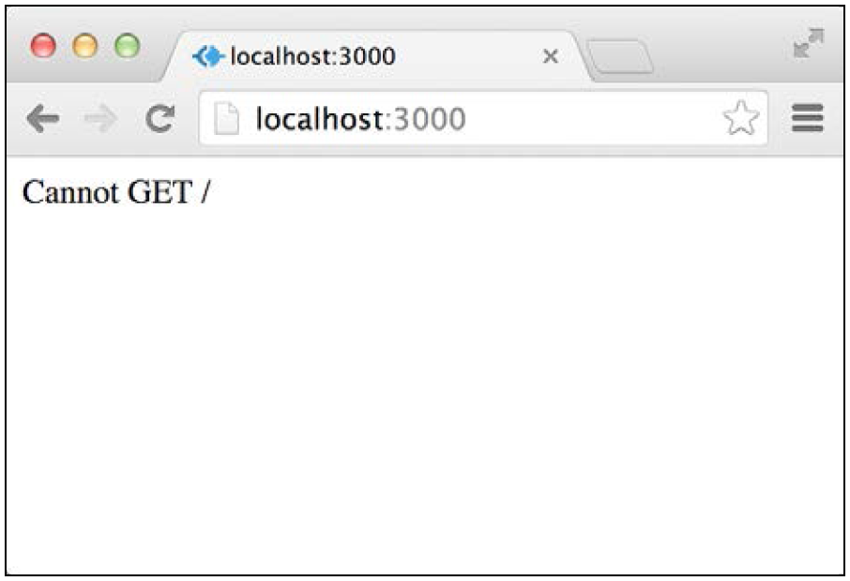
Meet the Connect module (cont’d)
Node will run your application, reporting the server status using the console.log() method.
You can try reaching your application in the browser by visiting http:// localhost:3000.
However, you should get a response similar to what is shown in the following screenshot:
What this response means is that there isn't any middleware registered to handle the GET HTTP request.

Slide 15
Connect Middleware
Connect middleware is just JavaScript function with a unique signature.
Each middleware function is defined with the following three arguments:
req: This is an object that holds the HTTP request information
res: This is an object that holds the HTTP response information and allows you to set the response properties
next: This is the next middleware function defined in the ordered set of Connect middleware

Slide 16
Connect Middleware (cont’d)
When you have a middleware defined, you'll just have to register it with the Connect application using the app.use() method.
Let's revise the previous example to include your first middleware.
Change your server.js file to look like the following code snippet:
var connect = require('connect');
var app = connect();
var helloWorld = function(req, res, next) {
res.setHeader('Content-Type', 'text/plain');
res.end('Hello World');
};
app.use(helloWorld);
app.listen(3000);
console.log('Server running at http://localhost:3000/');

Slide 17
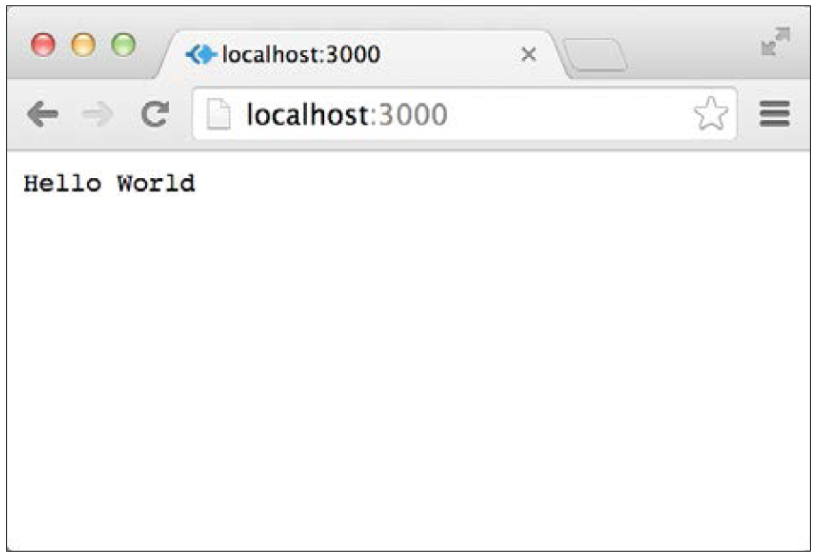
Connect Middleware (cont’d)
Then, start your connect server again by issuing the following command in your command-line tool:
$ node server
Try visiting http://localhost:3000 again.
You will now get a response similar to that in the following screenshot:

Slide 18
Mounting Connect middleware
As you may have noticed, the middleware you registered responds to any request regardless of the request path.
This does not comply with modern web application development because responding to different paths is an integral part of all web applications.
Fortunately, Connect middleware supports a feature called mounting, which enables you to determine which request path is required for the middleware function to get executed.
Mounting is done by adding the path argument to the app.use() method.
To understand this better, let's revisit our previous example.

Slide 19
Mounting Connect middleware (cont’d)
To understand this better, let's revisit our previous example -- modify your server.js file to look like the following code snippet:
var connect = require('connect');
var app = connect();
var logger = function(req, res, next) {
console.log(req.method, req.url);
next();
};
var helloWorld = function(req, res, next) {
res.setHeader('Content-Type', 'text/plain');
res.end('Hello World');
};
var goodbyeWorld = function(req, res, next) {
res.setHeader('Content-Type', 'text/plain');
res.end('Goodbye World');
};
app.use(logger);
app.use('/hello', helloWorld);
app.use('/goodbye', goodbyeWorld);
app.listen(3000);
console.log('Server running at http://localhost:3000/');

Slide 20

Intro to Express.js

Slide 21
Building an Express Web Application
The Express framework is a small set of common web application features, kept to a minimum in order to maintain the Node.js style.
It is built on top of Connect and makes use of its middleware architecture.
Its features extend Connect to allow a variety of common web applications' use cases, such as the inclusion of modular HTML template engines, extending the response object to support various data format outputs, a routing system, and much more.

Slide 22
Creating your first Express application
After creating your package.json file and installing express as one of your dependencies, you can now create your first Express application by adding your already familiar server.js file with the following lines of code:
var express = require('express');
var app = express();
app.use('/', function(req, res) {
res.send('Hello World');
});
app.listen(3000);
console.log('Server running at http://localhost:3000/');
module.exports = app;

Slide 23
The application, request, and response objects
Express presents three major objects that you'll frequently use.
The application object is the instance of an Express application you created in the first example and is usually used to configure your application.
The request object is a wrapper of Node’s HTTP request object and is used to extract information about the currently handled HTTP request.
The response object is a wrapper of Node's HTTP response object and is used to set the response data and headers.

Slide 24
The application, request, and response objects (cont’d)
The application object
The application object contains the following methods to help you configure your application:
app.set(name, value): This is used to set environment variables that Express will use in its configuration.
app.get(name): This is used to get environment variables that Express is using in its configuration.
app.engine(ext, callback): This is used to define a given template engine to render certain file types, for example, you can tell the EJS template engine to use HTML files as templates like this: app.engine('html’, require('ejs').renderFile).
app.locals: This is used to send application-level variables to all rendered templates.

Slide 25
The application, request, and response objects (cont’d)
The application object (cont’d)
app.use([path], callback): This is used to create an Express middleware to handle HTTP requests sent to the server. Optionally, you'll be able to mount middleware to respond to certain paths.
app.VERB(path, [callback...], callback): This is used to define one or more middleware functions to respond to HTTP requests made to a certain path in conjunction with the HTTP verb declared. For instance, when you want to respond to requests that are using the GET verb, then you can just assign the middleware using the app.get() method. For POST requests you'll use app.post(), and so on.
app.route(path).VERB([callback...], callback): This is used to define one or more middleware functions to respond to HTTP requests made to a certain unified path in conjunction with multiple HTTP verbs. For instance, when you want to respond to requests that are using the GET and POST verbs, you can just assign the appropriate middleware functions using app.route(path).get(callback).post(callback).
app.param([name], callback): This is used to attach a certain functionality to any request made to a path that includes a certain routing parameter. For instance, you can map logic to any request that includes the userId parameter using app.param('userId', callback).

